Slide 1

Compiler Design
Today’s Class Topics
-LALR(1) Parsing
-S/R and R/R Conflict
-How to Test CLR(1) and LALR(1) Grammar etc.
-Relationship amongst LL(1), LR(0), SLR(1), CLR(1) and LALR(1)
-YACC Tool
-SDT

Slide 2
Compiler Design

Slide 3
Compiler Design

Slide 4
Compiler Design

Slide 5
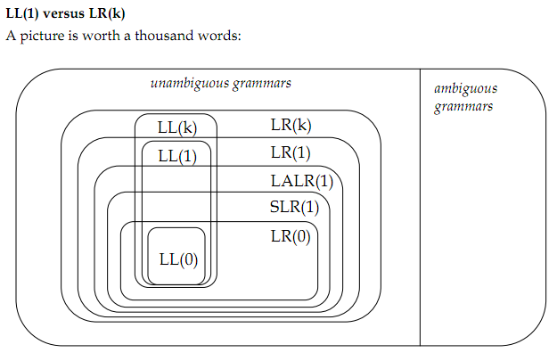
Compiler Design

Slide 6
Compiler Design

Slide 7
Compiler Design

Slide 8
Compiler Design

Slide 9
Compiler Design

Slide 10
Compiler Design

Slide 11
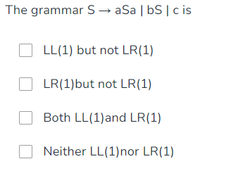
Compiler Design

Slide 12
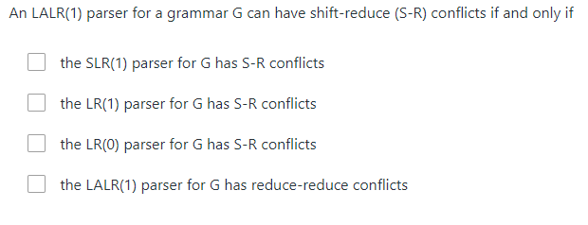
Compiler Design

Slide 13
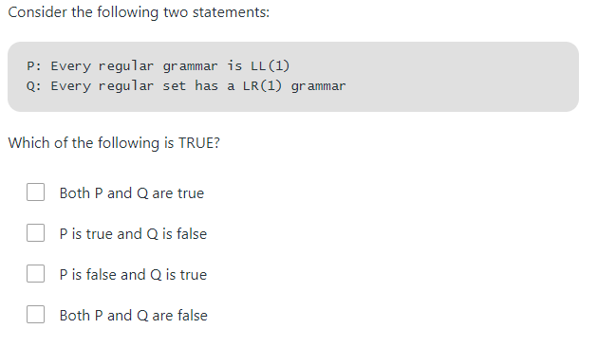
Compiler Design

Slide 14
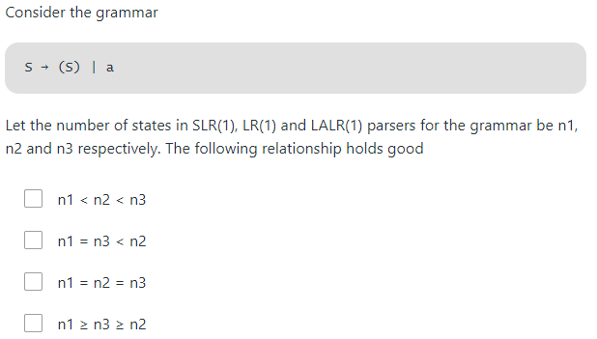
Compiler Design

Slide 15
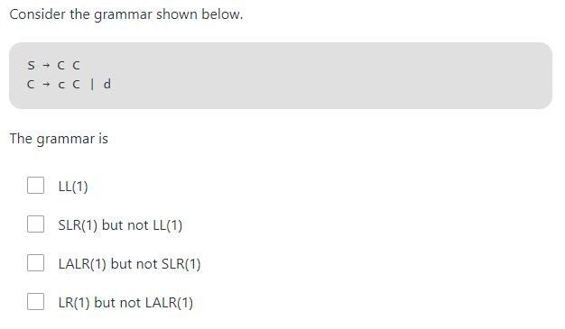
Compiler Design

Slide 16
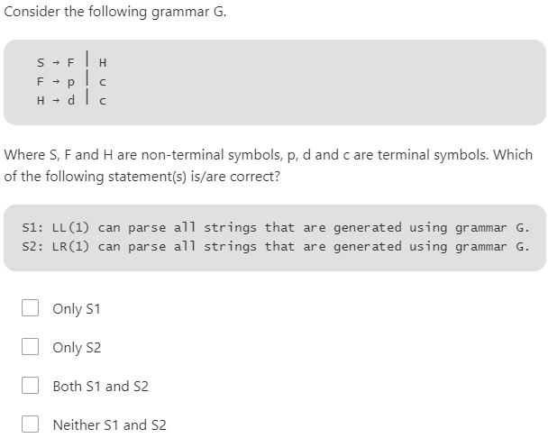
Compiler Design

Slide 17
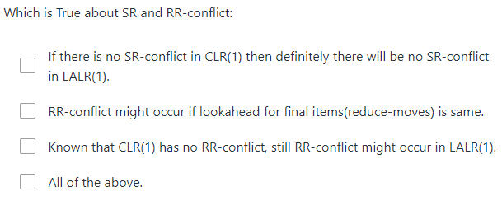
Compiler Design

Slide 18
Compiler Design
Syntax Directed Translation(SDT): A grammar with semantic rule is called as SDT

Slide 19
Compiler Design

Slide 20
Compiler Design

Slide 21
Compiler Design

Slide 22
Compiler Design

Slide 23
Compiler Design

Slide 24
Thank You !

